Slide 1
LB systém – konečný buffer
Teória informačných sietí
Andrej Kováč

Slide 2
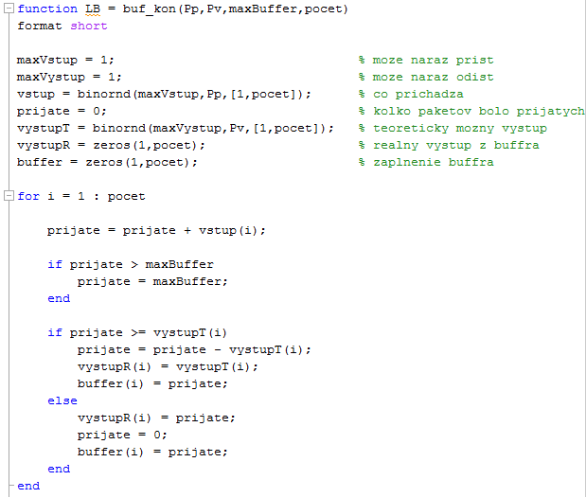
Zdroják

Slide 3
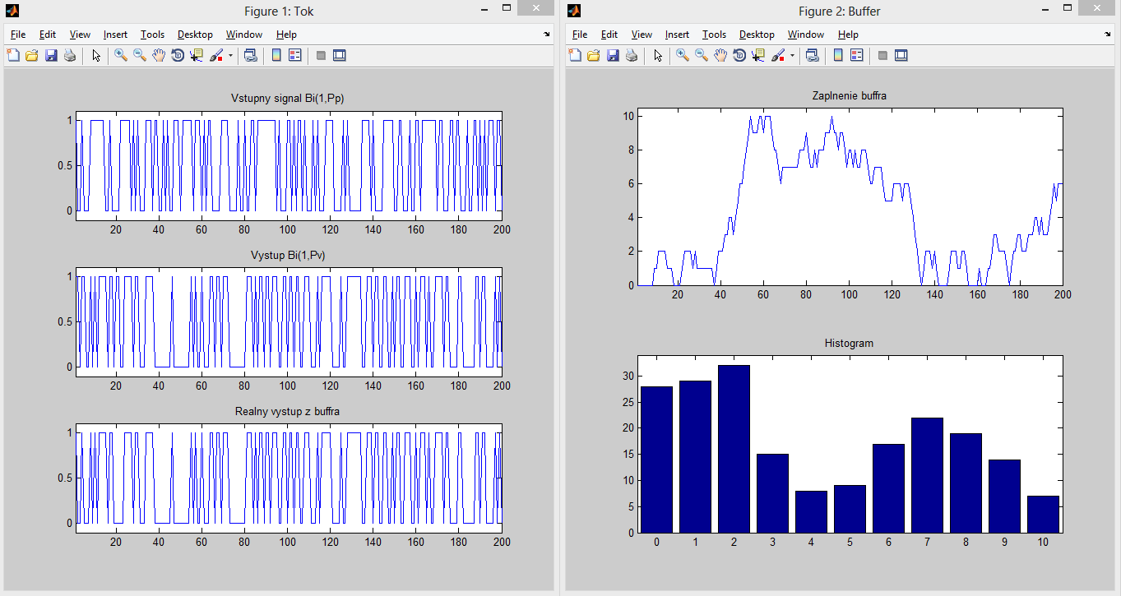
Pp = 0.5, Pv = 0.5, maxBuffer = 10, pocet = 200

Slide 4
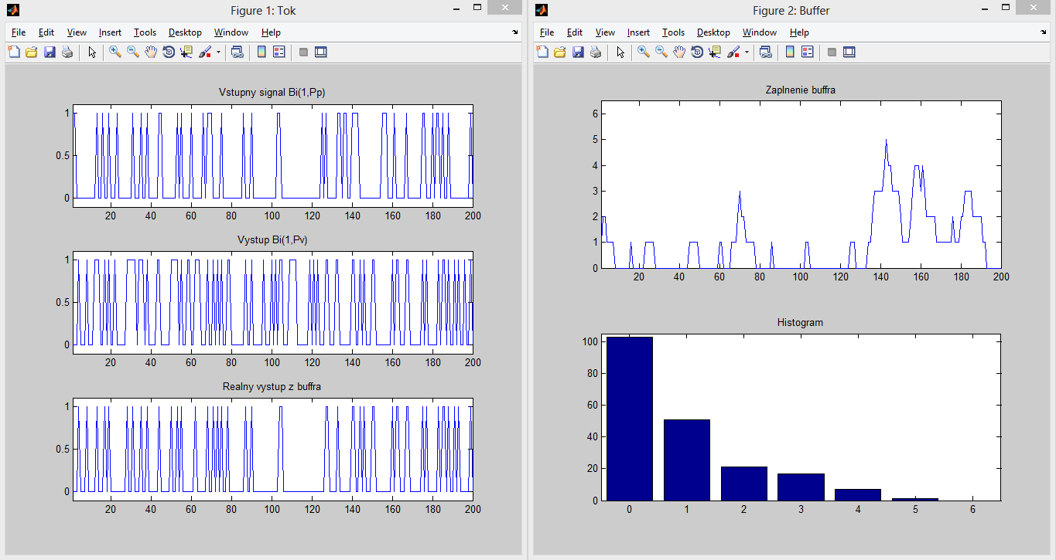
Pp = 0.25, Pv = 0.4, maxBuffer = 6, pocet = 200

Slide 5
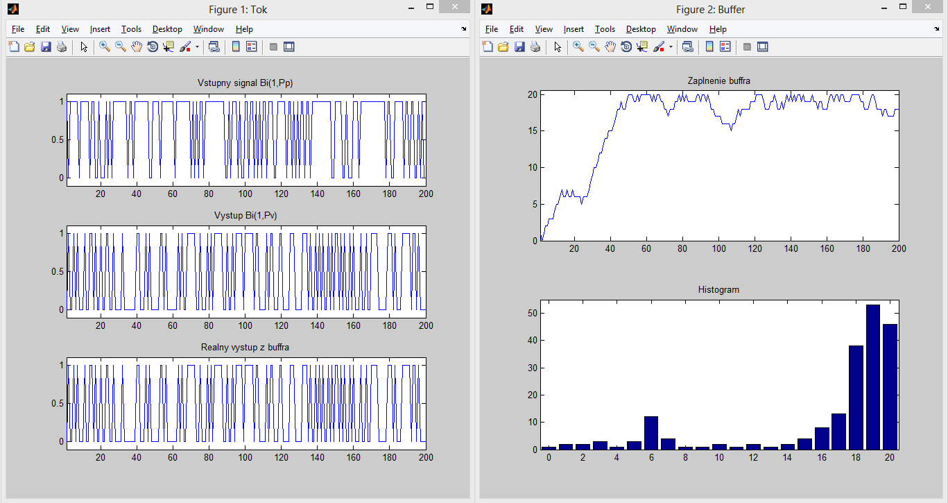
Pp = 0.3, Pv = 0.4, maxBuffer = 6, pocet = 200

